Slide 1

Computer Architecture and Logic Design (CALD) Lecture 01
Engr. Ramsha Mashood
Sr.Lecturer
Department of Software Engineering
Bahria University Karachi Campus
Email: RamshaMashood.bukc@bahria.edu.pk

Slide 2
Recommended Books
Computer Architecture and Organization, Designing for Performance by William Stallings, 10th Edition.
Computer Organization and Design, by David Patterson and John Hennessy, 5th Edition.
Digital Logic & Computer Design by M. Morris Mano, latest Edition.

Slide 3
Basic Concepts of Computer Architecture

Slide 4
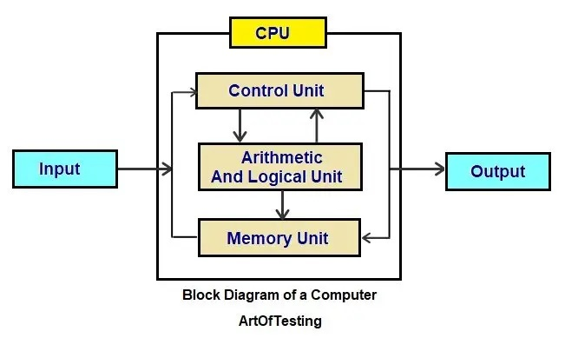
Block diagram of a Computer

Slide 5
Computer Architecture
Architecture refers to those attributes visible to the programmer or the attributes that have direct impact on the logical execution of a program.
Instruction set
Number of bits used for data representation
I/O mechanisms
Addressing techniques
Example: Architectural design issue - whether a computer will have a multiply instruction.

Slide 6
Computer Architecture
Computer architecture refers to the end-to-end structure of a computer system that determines how its components interact with each other in helping to execute the machine’s purpose (i.e., processing data), often avoiding any reference to the actual technical implementation.

Slide 7
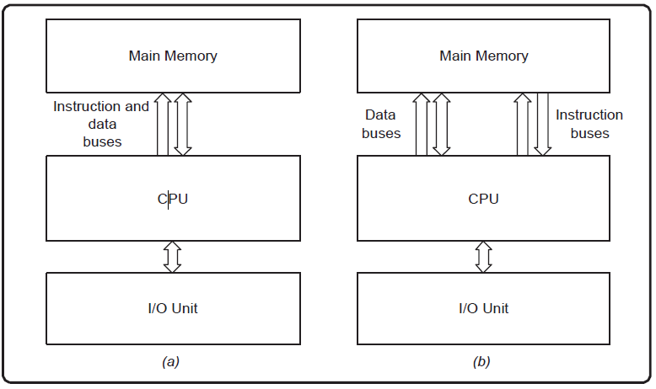
Computer Architecture
Examples of Computer Architecture: Von Neumann Architecture (a) and Harvard Architecture (b)

Slide 8
Predominant Approaches
Complex instruction set computer (CISC) and reduced instruction set computer (RISC) are the two predominant approaches to the architecture that influence how computer processors function.
CISC processors have one processing unit, auxiliary memory, and a tiny register set containing hundreds of unique commands. These processors execute a task with a single instruction, making a programmer’s work simpler since fewer lines of code are required to complete the operation. This method utilizes less memory but may need more time to execute instructions.
A reassessment led to the creation of high-performance computers based on the RISC architecture. The hardware is designed to be as basic and swift as possible, and sophisticated instructions can be executed with simpler ones.

Slide 9
How does computer architecture work?
Computer architecture allows a computer to compute, retain, and retrieve information. This data can be digits in a spreadsheet, lines of text in a file, dots of color in an image, sound patterns, or the status of a system such as a flash drive.
Data in numbers: The computer stores all data as numerals. When a developer is engrossed in machine learning code and analyzing sophisticated algorithms and data structures, it is easy to forget this.
Manipulating data: The computer manages information using numerical operations. It is possible to display an image on a screen by transferring a matrix of digits to the video memory, with every number reflecting a pixel of color.

Slide 10
How does computer architecture work?
Multifaceted functions: The components of a computer architecture include both software and hardware. The processor — hardware that executes computer programs — is the primary part of any computer.
Booting up: At the most elementary level of a computer design, programs are executed by the processor whenever the computer is switched on. These programs configure the computer’s proper functioning and initialize the different hardware sub-components to a known state. This software is known as firmware since it is persistently preserved in the computer’s memory.
Support for temporary storage: Memory is also a vital component of computer architecture, with several types often present in a single system. The memory is used to hold programs (applications) while they are being executed by the processor and the data being processed by the programs.

Slide 11
Computer Organization
Organization refers to the operational units and their interconnections that realize the architectural specifications.
Organizational attributes include those hardware detail transparent to the programmer.
Control Signals
Interfaces between the computer and peripherals
Memory technology
Example: Organizational issue – is there a special multiply unit or is it done by repeated addition.

Slide 12
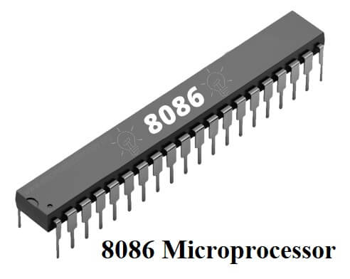
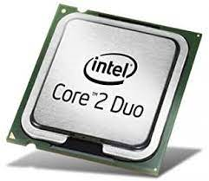
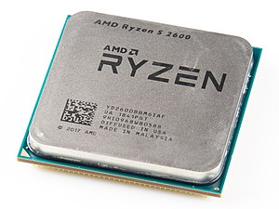
Architecture and Organization
Computer manufacturers offer a family of computer models all with same architecture but differences in organization.
Different models - different prices and performance characteristics.
Examples:
All Intel x86 family share the same basic architecture
The IBM System/370 family share the same basic architecture
This gives backward code compatibility.
Organization differs between different versions.

Slide 13
Structure and Function
Structure is the way in which components relate to each other
How different components, like ALU, control, I/O, and memory are connected?
How they interface with each other?
Function is the operation of individual components as part of the structure
What is the function of a component?

Slide 14
Functions of a Computer
Data Processing
Data may take a wide variety of forms
Performing various operations on data
Data Storage
Short and long term data storage
Data Movement
Input-Output: Data is received from or delivered to a device that is directly connected to the computer. The device is referred to as a peripheral.
Data Communications: Data is moved over longer distances, to or from a remote device.
Control
A control unit manages the computer’s resources.

Slide 15
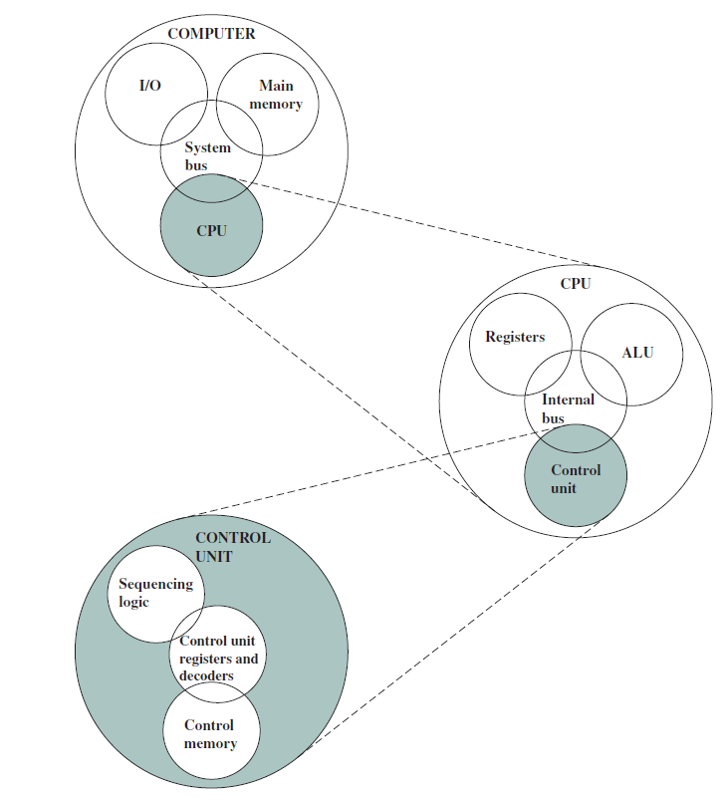
Top Level Structure of a Computer

Slide 16
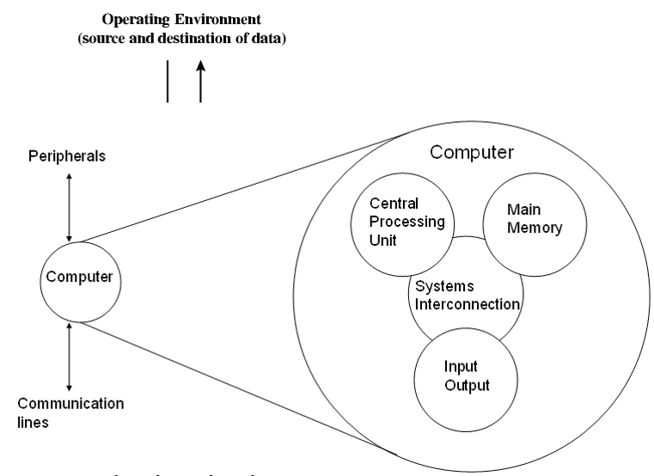
Structural Components: Computer
Central Processing Unit (CPU):
Controls computer operations and performs data processing
Main Memory:
Stores data
I/O:
Data movement to and from computer and external environment
System Interconnection:
Communication among CPU, main memory and I/O.

Slide 17
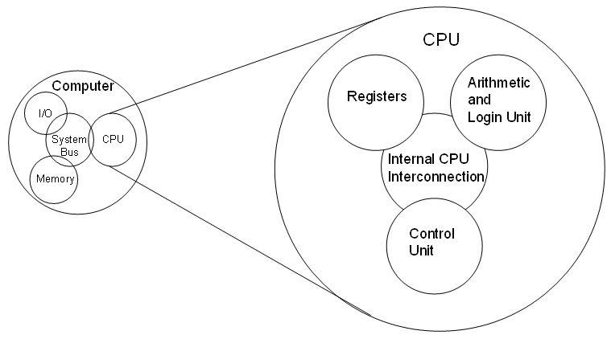
Structural Components: CPU
Control Unit:
Controls the operations of a CPU.
Arithmetic and Logic Unit (ALU):
Performs the computer’s data processing functions.
Registers:
Provides internal storage to CPU.
CPU Interconnection:
Communication among the control unit, ALU, and registers.

Slide 18
Multicore Computer Structure
Computers generally have multiple processors
Multicore computer – multiple processors reside on a single chip.
Each processing unit is called a core and it consists of a control unit, ALU, registers, and cache memory.

Slide 19
Multicore Computer Structure
Central Processing Unit (CPU):
The portion of a computer that fetches and executes instructions.
It consists of an ALU, a control unit and registers.
Core:
An individual processing unit on a processor chip.
Equivalent in functionality to a CPU on a single-CPU system.
Processor:
A physical piece of silicon containing one or more cores.
Interprets and executes instructions.
If a processor contains multiple cores it is referred to as a multicore processor.

Slide 20
Cache Memory
Cache memory lies between the processor and main memory.
It is smaller and faster than main memory.
It is used to speed up memory access, by placing data from main memory into cache memory that is likely to be used in near future.
Multiple levels of cache (L1, L2, L3, ...) can be used to improve performance.
Level L1 is closest to the core and additional levels (L2, L3, and so on) are farther away from the core.
Level n is smaller and faster than level n+1.

Slide 21
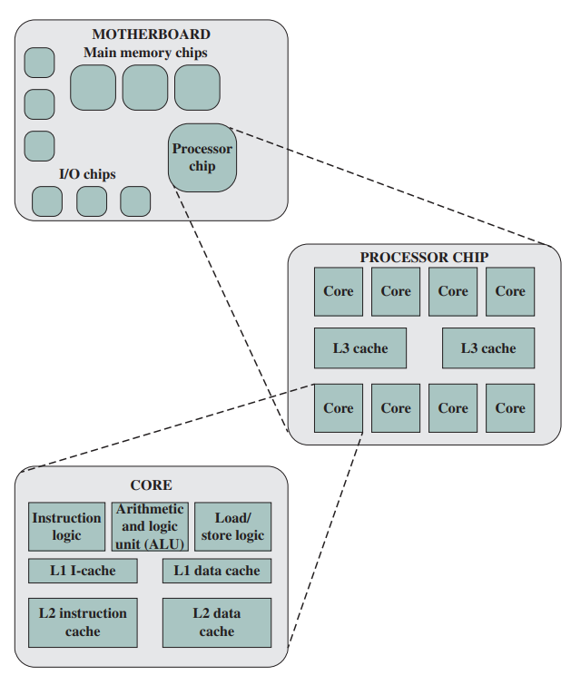
Elements of a Multicore Computer

Slide 22
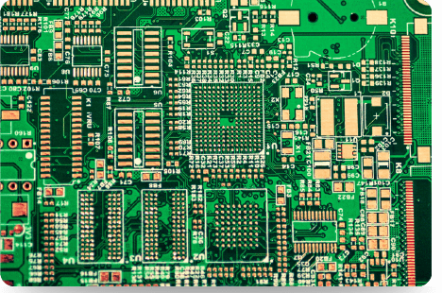
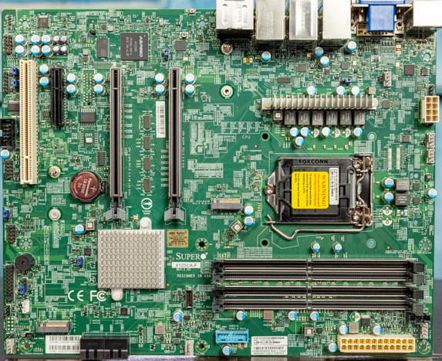
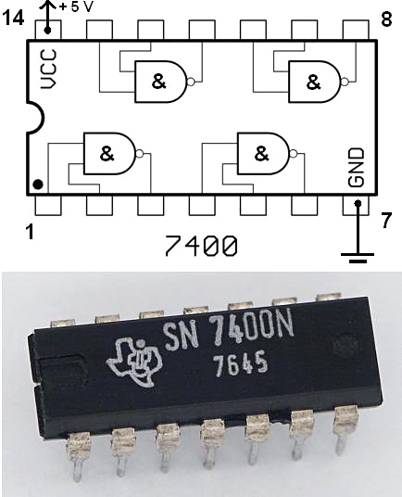
Elements of a Multicore Computer
Printed Circuit Board (PCB):
A rigid, flat board that holds and interconnects chips and other electronic components.
Motherboard:
Motherboard is the main printed circuit board (PCB) in a computer.
It is also known as system board.
Chip:
The most prominent elements on the motherboard are called chips.
A chip is a single piece of semi-conducting material, typically silicon, upon which electronic circuits and logic gates are fabricated.
The resulting product is referred to as an Integrated Circuit (IC).

Slide 23
Elements of a core
Instruction Logic:
Fetching and decoding instructions.
Determine instruction operations and memory locations of any operands.
Arithmetic and Logic Unit (ALU):
Performs the operation specified by an instruction.
Load/Store Logic:
Manages the transfer of data to and from main memory via cache.
Instruction Cache:
Used for transfer of instructions to and from main memory.
Data Cache:
Used for transfer of operands and results to and from main memory.

